Slide 1


Slide 2
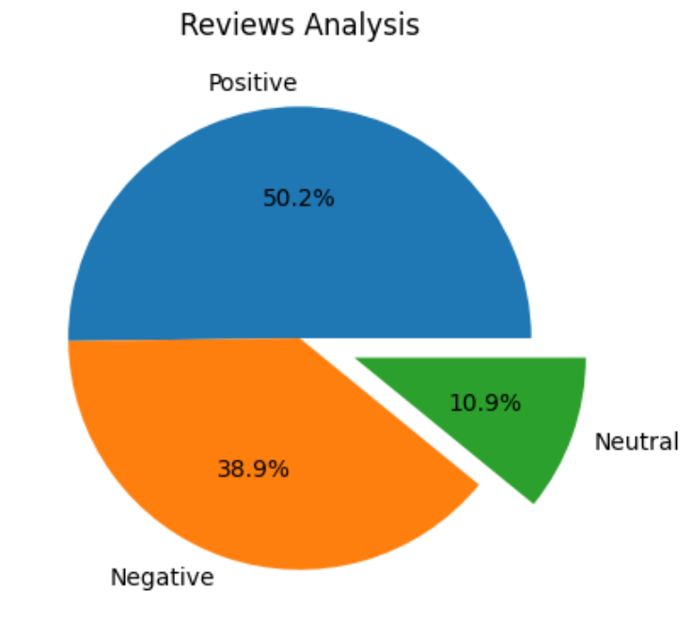

Review Analysis

Slide 3
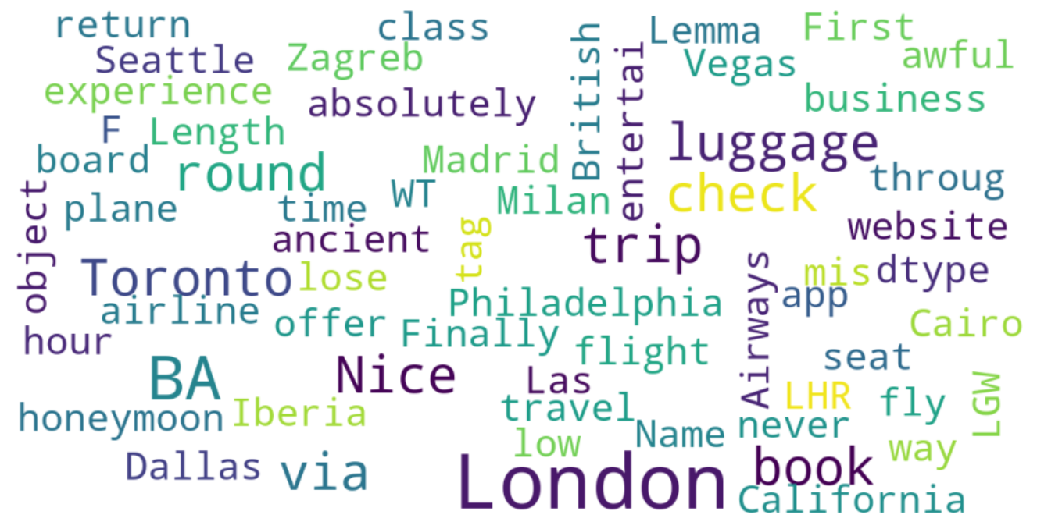
Listing the common words via Lemmatization

